Slide 1


Final Year Project Presentation
Word Difficulty Prediction Using Phonetics
Presented by:
Abhinav Panse
(EN16CS301008)
Shivam Parihar
(EN16CS301245)
Project Mentor:
Dr. Ruchi Patel
Assistant Professor, CS Department

Slide 2

What is Word Difficulty Predictor?
Word Difficulty Predictor is used to measure how hard the word is difficult to pronounce.
The ML Model is used to predict 3 categories (Easy, Medium and Hard) based on the Phonetic translation of the word.
Thus, we use Phonetic translation of words to measure its complexity or its difficulty.
Most of the models developed yet, uses frequency to determine the difficulty of the word.
We have used Recurrent Neural Network, a Deep Learning Model in our project.

Slide 3
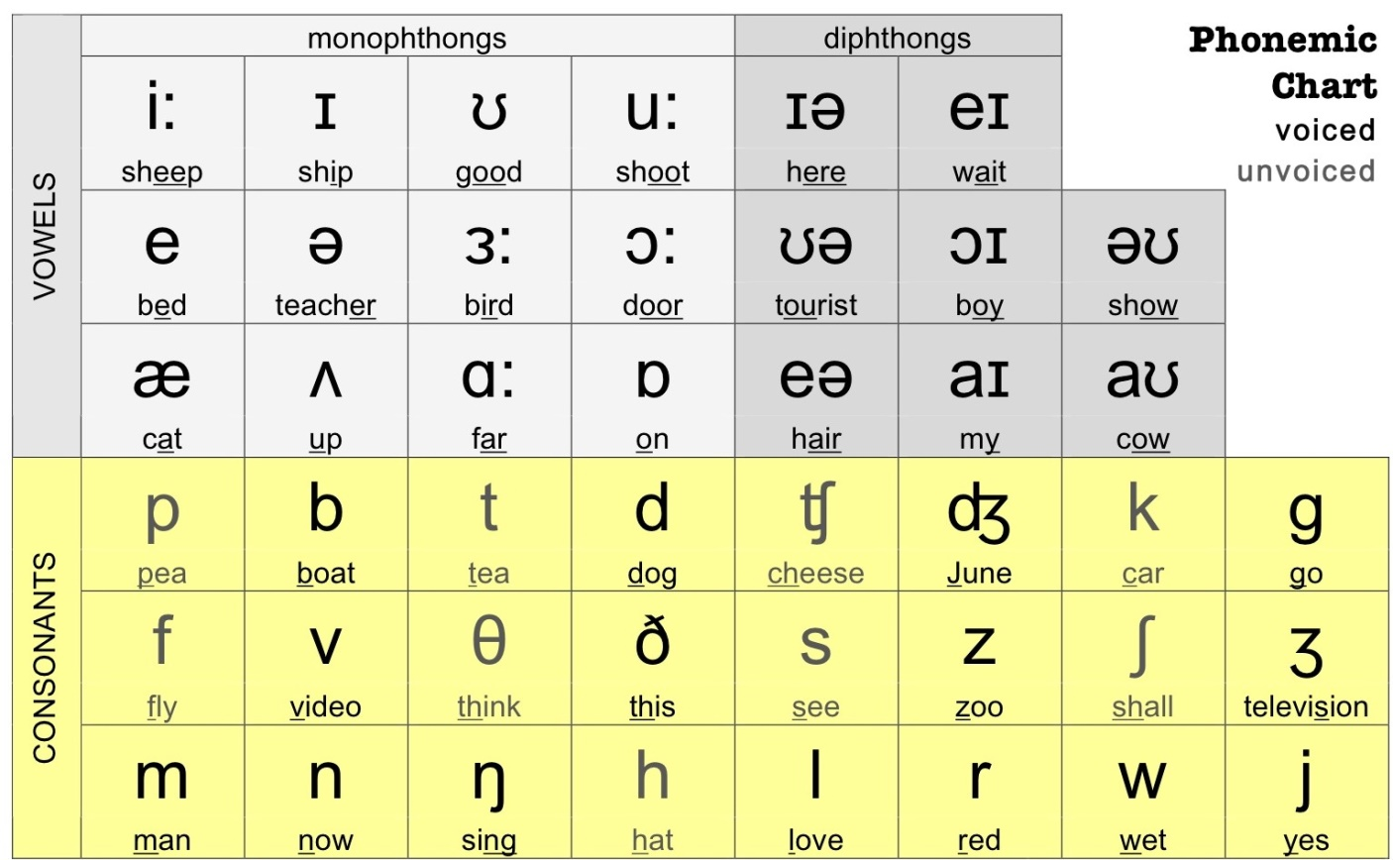
What are Phonetics?
Phonetics is a branch of linguistics that studies the sounds of human speech
A phoneme is the basic building block of words that distinguishes one word from another in a particular language.
What our model grasp?
Our model try to find relation between phonemic symbols that makes the word hard to pronounce.
Ex-
Quire
['k', 'w', 'aɪ', 'ɪə', 'ə']
Pharaoh
['f', 'eə', 'ə', 'r', 'əʊ', 'ʊ']

Slide 4
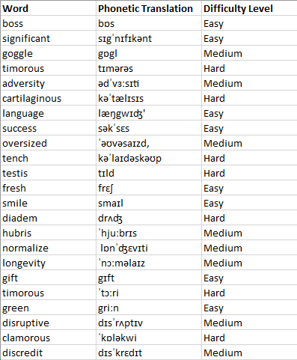
Dataset
Balanced dataset is prepared for training with total of about 1800 entities out of which 1400 is used for training and 400 is for testing.
Dataset class split-
Difficulty Level | Training Data (figure) | Testing Data (figure)
Easy | 451 | 141
Medium | 473 | 132
Hard | 476 | 127
Total | 1400 | 400

Slide 5




Word
Phonetic Translation of Word
Phonetic Translation
Input
Easy
Medium
Result
Hard
ML Model

Slide 6
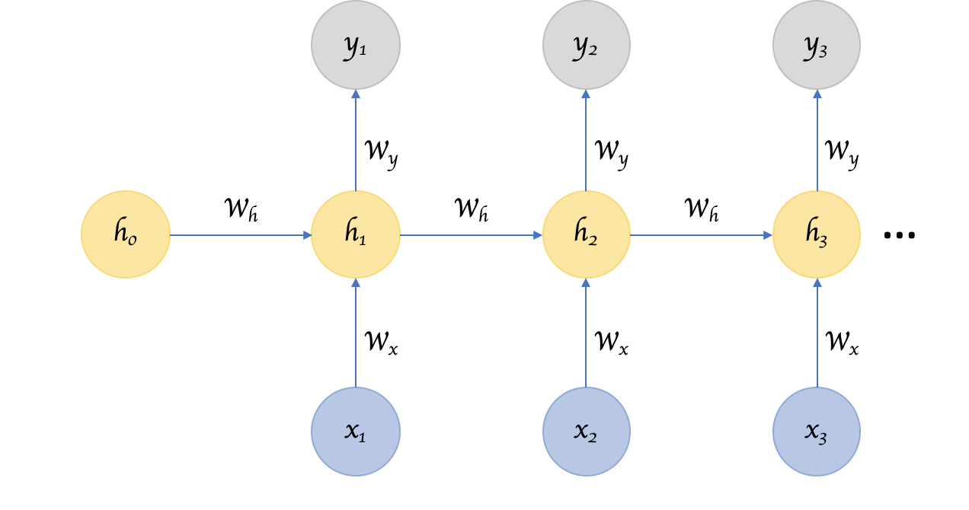
Recurrent Neural Network
A recurrent neural network (RNN) is a class of artificial neural networks where connections between nodes form a directed graph along a sequence.
They remember things learnt from prior input(s) while generating output(s).
Problem With RNN
During back propagation, RNN suffer from the vanishing gradient problem.
The vanishing gradient problem is when the gradient shrinks as it back propagates through time. If a gradient value becomes extremely small, it doesn’t contribute too much learning.

Slide 7
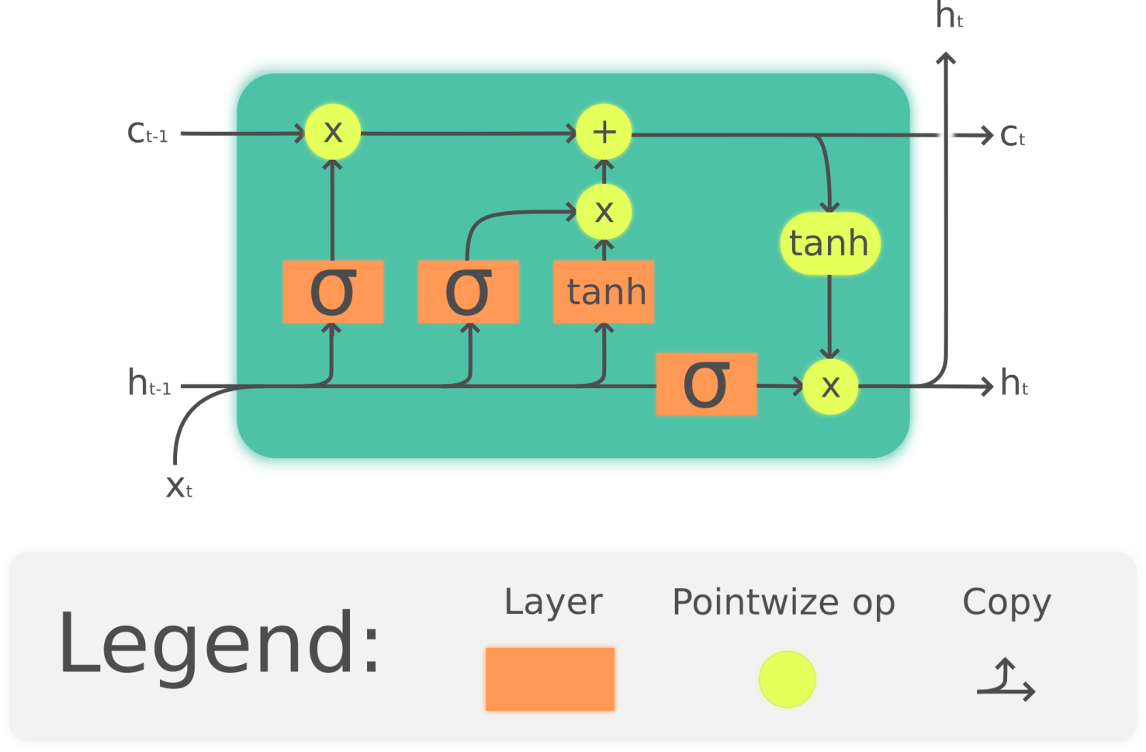
Long Short Term Memory
Long short-term memory (LSTM) is an artificial recurrent neural network (RNN) architecture.
LSTM networks are capable of learning order dependence in sequence prediction problems.

Slide 8
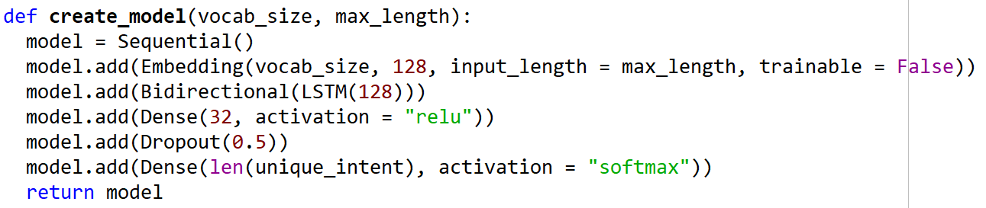
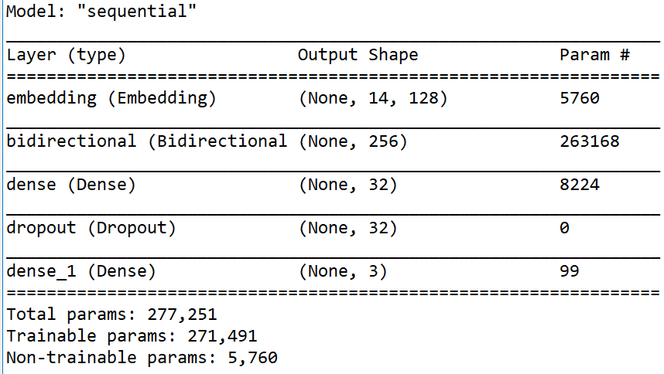
Machine Learning Model
Recurrent Neural Network with LSTM cell and 5 layers.

Slide 9
Step By Step Procedure
Step 1- Take Input from the user.
word = “Squirrel”
Step 2- Call ToPhonetic API to get transcribed word.
transcribed word = “skwɪrəl”
Step 3- Preprocessing on transcribed word to convert into phoneme list.
transcribed word list = ['s', 'k', 'w', 'ɪ', 'r', 'ə', 'l']
Step 4- Converting the list into integers.
integer list = [33, 27, 43, 2, 42, 8, 41]
Step 5- Converting simple list to Numpy array.
numpy array = [[33 27 43 2 42 8 41]]

Slide 10
Step By Step Procedure
Step 6- Adding Post Padding to the Numpy array.
padded array = [[33 27 43 2 42 8 41 0 0 0 0 0 0 0]]
Step 7- Providing padded array as input to the RNN model and getting predictions.
pred = model.predict_proba(padded_array)
pred = [[0.04600 0.854000 0.10000]]
P(easy) P(Medium) P(Hard)
Step 8 - Returning result Tag and confidence
Result Tag– Medium
Confidence – 85.40%

Slide 11
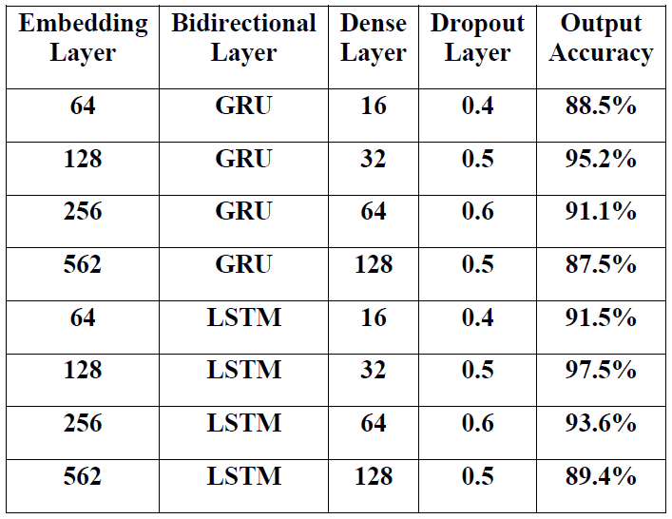
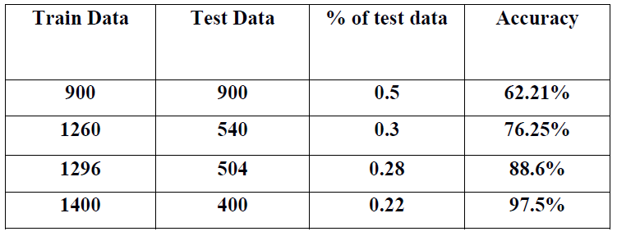
Selections of Values
Comparison of performance -
Dataset Split –

Slide 12
Results
Confusion matrix-
Final Accuracy- 97.5%
Difficulty Level | Easy | Medium | Hard
Easy | 138 | 1 | 0
Medium | 2 | 128 | 3
Hard | 1 | 3 | 124

Slide 13
How Word Difficulty predictor will make an impact?
There is no model yet.
It save effort, time by Tagging thousands of words in seconds.
It use phonetics which is the base of English language.
Can be used by language training institutes for educational purposes.

Slide 14
Future Scope
Increase in speed and accuracy of the model.
From more training data of people of different nationalities we can make model for different accents.
Identification of oratory diseases.

Slide 15
Journal Details
Journal Name: 1st International Conference on Contemporary Issues in Computing – ICCIC 2020
Authors Name: Shivam Parihar, Shubhi Miradwal, Abhinav Panse, Ruchi Patel
Topic: Word Difficulty level prediction system using Deep Learning Approach
Detail: Accepted as a Regular Paper for presentation at ICCIC 2020 on April 22, 2020.

Slide 16
Thank You

